Slide 1

Windows ME
By Tanner, Ancel, and Brandon

Slide 2
The History of Windows ME
By Tanner Waters

Slide 3
Unity
"Now I plead with you, brethren, by the name of our Lord Jesus Christ, that you all speak the same thing, and that there be no divisions among you, but that you be perfectly joined together in the same mind and in the same judgment," (1 Cor. 1:10).

Slide 4
The making of ME
Windows 200 was an enterprise product
Created by one of 5 new divisions called the Windows Consumer Division
Wished to Create a final release of 9x
Wanted to switch to an all-NT codebase (No tax)

Slide 5
The First Disaster
Steve Ballmer announced a on April 7th new OS at WinHEC – Windows Hardware Engineer Conference
Announced follow-up to Windows 98 SE
Bill Gates already announced 98 was the end of 9x
Announced it would ship later in the Spring that year

Slide 6
Beta Testing
July 1st 1999 testers received invites for the beta
Developer Release 1 described as pre-beta began
Sent to developers and technical reviewers
Essentially was 98’s color scheme, windows 2000 icons, and a new Orange web view
Windows DR2 out two weeks later and DR3 out a week after DR2
August 24th 1999, DR4 was release and dubbed “Beta One”

Slide 7
Beta one
September 19th 1999 “preferred members” were included
A list was sent requiring a Pentium 150 or better, 32mb of ram, and 320-550mb of hard disk space
Not much was changed, and many things just did not work
System restore did not work
Internet Explorer tried to work but rarely did
Much of the marketing inside the OS still said Windows 98

Slide 8
Disaster 2
Early October rumors surfaced from the Microsoft Engineers that ME had been canceled
Article published in WinInfo on October 8th
Article thought it would be interesting if true, but said it was just a rumor
Article spread like wildfire
Waggener Edstrom head of public relations said “it was that kind of weekend”
ME was not canceled and scheduled for a 2000 release

Slide 9
Beta 2
November 24th 1999 Beta 2 was released
Tweaked for performance and stability
Application manager, game option control panel, System File Protection, Phone dial-up, scanners and cameras options added
Windows Auto update, Windows Media player, MSN Messenger service, added
Internet Explorer 5.5 added enhanced printing capabilities, performance, and integrated platform support

Slide 10
Delays and Beta 2 refresh
TCP/IP added from windows 2000 created significant delays
January 21, 1999 Beta 2 refresh released and concerned many
Many people expected Beta 3 and was concerned
Windows Neptune and Odyssey were scrapped projects that raised more concern
Only significant update was AutoUpdate was released as a win32 version which went to release

Slide 11
Windows ME is born
February 1st 1999, Microsoft released a press statement announcing Microsoft 2000 Millennium edition
Later announced they would product the OS as Windows ME to stay hip and competitive
February 11th Windows start screen debuted a startup and shutdown sound for ME
Windows movie maker soon added
By the end of February it was all coming together

Slide 12
Beta 3 and the year 2000
Companies became angry after a rumor that enterprise network features would not be supported
Eventually added in but adamantly opposed to pursue the home aspect of ME
Beta 3 launched April 11th 2000 alongside Windows media player 7
Beta 3 notes
System restore finally worked
Internet connection sharing
Multiplayer gaming over home network
Digital camera integration
Boasted faster startup than 98, iMac, and Sony PlayStation

Slide 13
The release of ME
Windows ME finally signed off for release on June 28th 2000
Retail availability held back until September 14th
$209 for full-package product (same as 98)
$109 for a version upgrade
Many users reported problems installing ME
Problems getting it to work with non-Dell hardware
Problems getting ME to shutdown
Many users stayed with 98 or even opted to upgrade to 2000 despite it being enterprise based
Microsoft planes to stop support in 2004, but kept support until July 11th 2006
Microsoft pulled Microsoft Internet Games Services on July 31, 2019

Slide 14
Works Cited
Paul Thurrott https://www.itprotoday.com/windows-server/road-gold-development-windows-me July 5th, 2000. Web. Feb. 9th ,2020.
https://news.microsoft.com/2000/06/19/microsoft-windows-millennium-edition-released-to-manufacturing/ June 19th ,2000. Web. Feb. 9th ,2020

Slide 15
DEVO
Philippians 4:6-7:
“Do not be anxious about anything, but in everything by prayer and supplication with thanksgiving let your requests be made known to God.
Matthew 6:25-26:
Therefore I tell you, do not worry about your life, what you will eat or drink; or about your body, what you will wear. Is not life more than food, and the body more than clothes? Look at the birds of the air; they do not sow or reap or store away in barns, and yet your heavenly Father feeds them. Are you not much more valuable than they?

Slide 16
Benefits of ME
The things that stayed
By: Ancel Carson

Slide 17
Different Areas of Improvement
Developer
Windows Image Acquisition API
Generic drivers for USB
Faster Boot Times
User
System Restore
Movie Maker
Auto Updates
Image Preview
Net Crawler

Slide 18
Developer Improvements
Windows Image Acquisition API
Enables graphics software to communicate with imaging hardware
Scanners, Digital Cameras, Digital Video Equipment.
Provides a unique framework where a device can inform a computer of its capabilities.
Generic drivers for USB
First OS from the Windows 9x Series that implemented generic drivers for USB devices.
Mass Storage Devices, Printers
Standard support for 5-button mice
Faster Boot Times
Removal of Real mode DOS

Slide 19
User Improvements
System Restore
Allowed a user to return their machine to an earlier version
Movie Maker
Basic video capture and editing capabilities
Auto Updates
Automatically downloaded and installed critical Windows updates
Image Preview
Allowed a user to view, rotate, room in/out, or print photos
Net Crawler
Automatically searched for devices and printers in the My Network space.

Slide 20
References
https://en.wikipedia.org/wiki/Windows_Me
https://en.wikipedia.org/wiki/Windows_Image_Acquisition

Slide 21
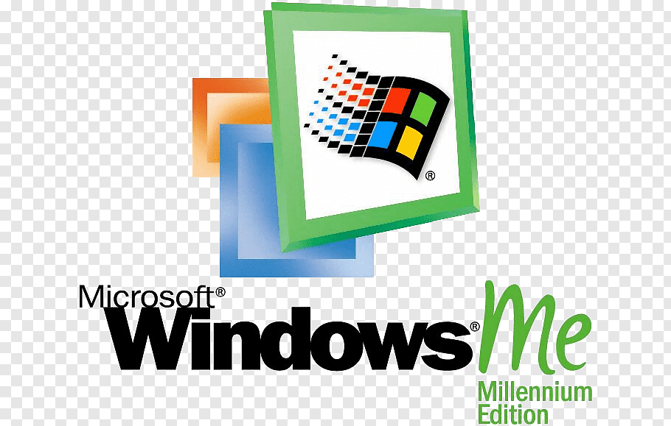
MISTAKE EDITION
PCWorld’s #4 worst tech product. Ever.

Slide 22
“Might be the worst version of Windows ever released” - Dan Tynan, PCWorld
Why was it so bad?
Extremely rushed released schedule
Very buggy Developer Releases
System Restore
Removed DOS mode
Garbage IE Edition
General Slowness, Crashes, and Strange Performance Issues

Slide 23
Release Schedule? And other great jokes you can tell yourself
Bill Gates said Windows 98 was the end of 9x line
Steve Ballmer announced Me as a follow-up to 98SE
April 7th, 1999 announce date
Spring 2000 release date
July 23st, 1999– First Developer Preview (DR1)
July 30th, 1999 – DR2
August 6th, 1999 – DR3
September 19th, 1999 – DR4 (aka the First Beta)
November 24th, 1999 – DR5 / Beta 2
April 7th, 2000 – DR6 / Beta 3

Slide 24
Developer Releases
PC Simplicity: “It Just Works”.
Digital Media and Entertainment
Home Networking
The Online Experience
Essentially just Windows 98 SE with very few small changes
Windows 98 color scheme
Icons from Windows 2000
Ugly orange color scheme for IE
Welcome to Windows
Showed Windows 98 intro

Slide 25
System Restore
What it was supposed to do…
Makes it possible to go back to a previous known good configuration
Restore Points were automatically created as regular events, so a Restore Point was always available
What it did
Restored Malware
Nothing

Slide 26
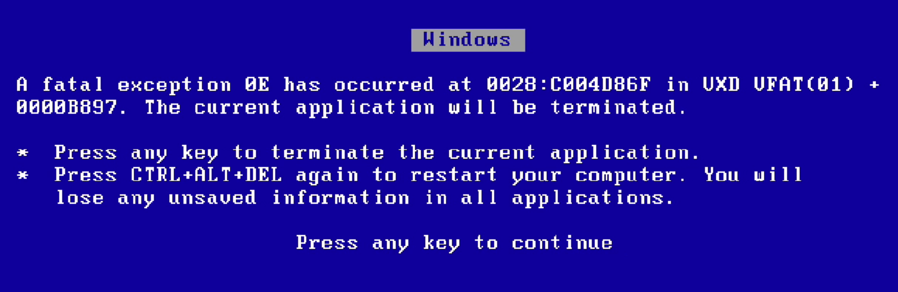
Bye Bye DOS
Rumored that DOS would be removed
Removed “Real Mode DOS”
Legacy environment that older MS-DOS programs ran in
Implications
Boots up more quickly and more reliably
More stable
Older DOS apps and some Windows apps wouldn’t run
Cannot boot into DOS mode
Partition Magic

Slide 27

Slowness, Crashes, Bugs
Pentuim II, 300mhz
64 MB Ram
2 GB HDD
Very finnicky with more than 512 MB ram
Frequent boot-loops with 1.5 GB+
IE Garbage 5.5 release
IE refused to run sometimes
Bloatware – Media Player 7 / Movie Maker

Slide 28
Works Cited
https://www.itprotoday.com/windows-server/windows-millennium-edition-windows-me-review
https://www.itprotoday.com/windows-server/road-gold-development-windows-me
https://www.pcworld.com/article/125772/worst_products_ever.html?page=2
https://microsoft.fandom.com/wiki/Windows_Me

